Slide 1
Discovering Valuable Trade Assets
For the Orlando Magic
Based on WAR and RAPTOR
Researched by Andrew Cafiero

Slide 2
The problem
Lack of star
Offense is lacking
Star power is winning power. A nucleus to the organism is essential for successful results. A veteran presence will help bring a change.
Without a plan and someone to work the offense around, key offensive metrics will continue to stagnate.

Slide 3
The Data

Slide 4
Wins Above Replacement
Robust Algorithm using Player Tracking and On/Off Ratings
Player Impact of Team Possessions per 48min
WAR
PREDATOR
RAPTOR
On/Off
PACE
Predictive points above average
Points above average with Plus/Minus

Slide 5
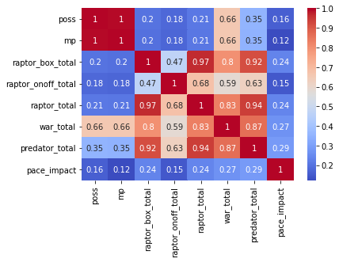

Slide 6
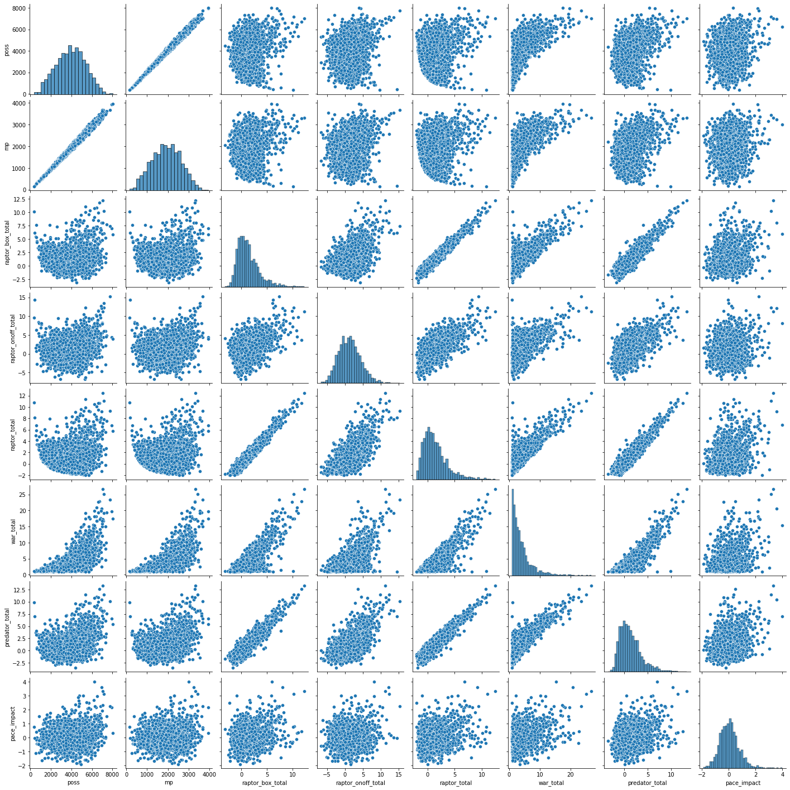

Slide 7
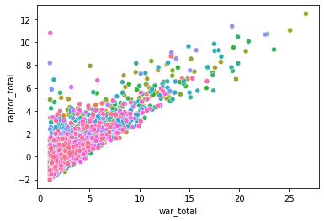

Slide 8
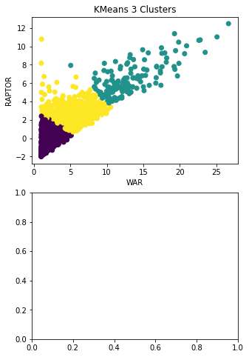
Our Model
Based on RAPTOR and WAR

Slide 9
The Classification
STRENGTHS
WEAKNESSES
-
-
-
-

Slide 10
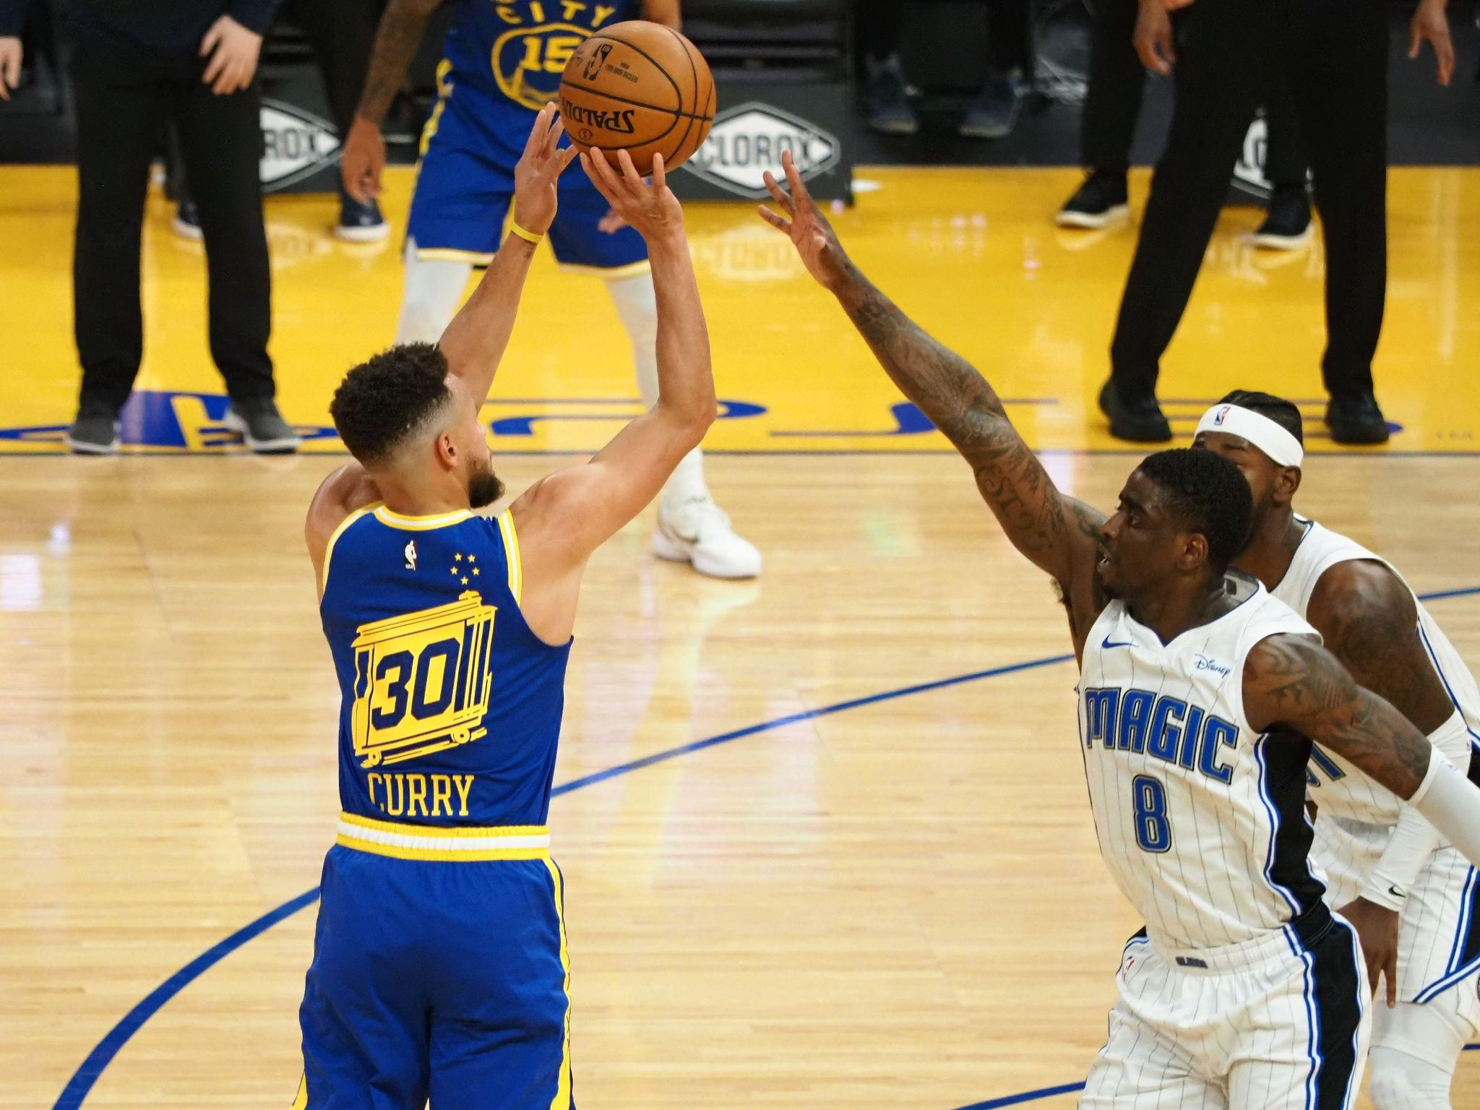
Result
Ladies and gentlemen,
We got him.

